Slide 1
OPTIMAL RESOURCE ALLOCATION
Using Simulated Annealing
Assigning drones to task zones under battery constraints
Team Members
Name: Gourav Saha
Roll no.: 25WU0101042
Name: Yash Raj
Roll no.: 25WU0102307
Name: Pranav Yeddula
Roll no.: 25WU0102311
Name: Morla Kartik
Roll no.: 25WU0102166
Name: Shwechitch
Roll no.: 25WU0102261
Course: Foundations of AI
Faculty: Dr. N. Steven Raj

Slide 2
PROBLEM STATEMENT
Which drone should serve which zone?
A fleet of drones must service a set of task zones (delivery points, survey sites, disaster-relief targets). Each zone needs exactly one drone; a drone may serve several zones.
Goal: minimize total travel distance across the fleet, while respecting a per-drone battery / range cap.
DRONE → ZONE
3–4
6–8
1
Drones (agents)
Zones (tasks)
Zone per assignment slot
▲ Drones ● Zones
2

Slide 3
METHOD
What is Simulated Annealing?
Inspired by metal annealing: a hot metal is cooled slowly so its atoms settle into a low-energy, stable arrangement instead of freezing into the first shape they hit.
ACCEPTANCE RULE
P(accept) = exp( −Δcost / T )
1
Start
Random zone→drone assignment, high temperature T
High T (early): frequently accepts worse moves → explores broadly, escapes local optima.
Low T (late): rarely accepts worse moves → fine-tunes around a good solution.
2
Explore
Try a neighbor move: swap or reassign one zone
3
Decide
Always accept if better; accept worse with prob. exp(−Δcost / T)
4
Cool
Reduce T each step (T ← T × 0.995) and repeat
3

Slide 4
METHODOLOGY
From random instance to compared solutions
1
2
3
4
Problem Setup
Cost Function
SA Solver
Greedy Baseline
Random 2D coordinates for N drones (3–4) and M zones (6–8).
Sum of Euclidean drone→zone distances, plus a penalty if a drone's total distance exceeds its battery cap.
1,500 iterations: swap/reassign moves, Metropolis acceptance, geometric cooling (×0.995/step).
Each zone independently picks its nearest drone — fast, but ignores load balance.
4

Slide 5
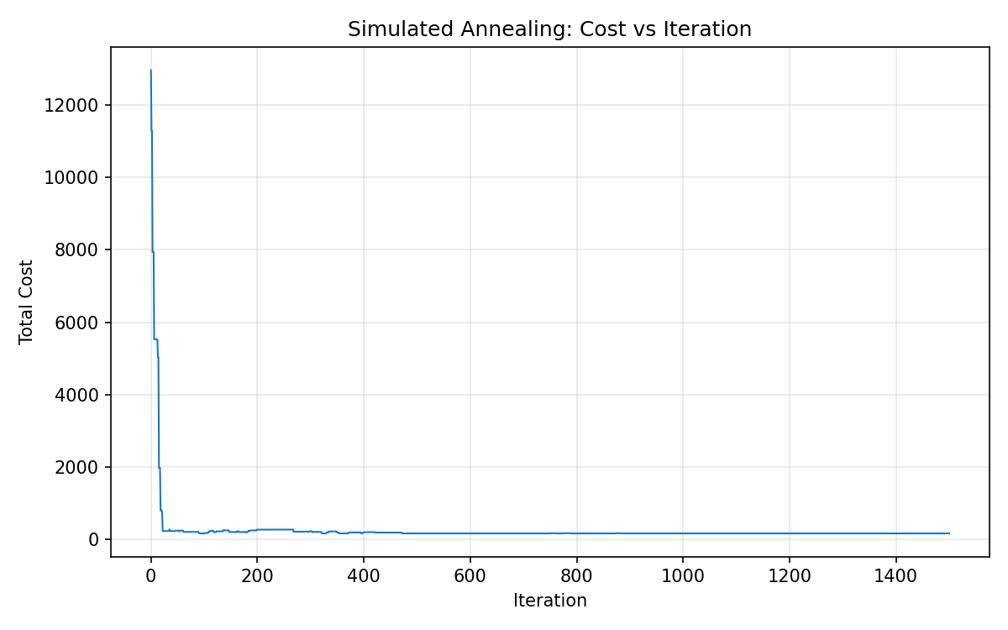
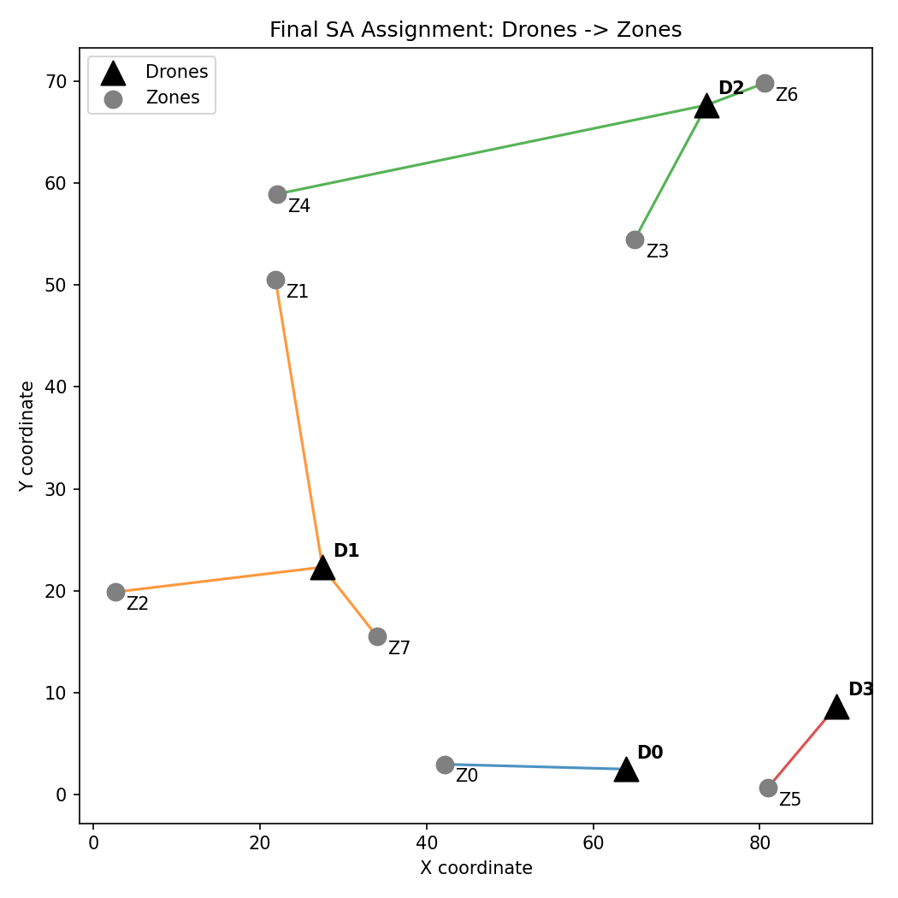
RESULTS
SA converges to a battery-safe, low-cost plan
Cost drops sharply as SA escapes an infeasible random start, then settles once battery limits are respected.
5

Slide 6
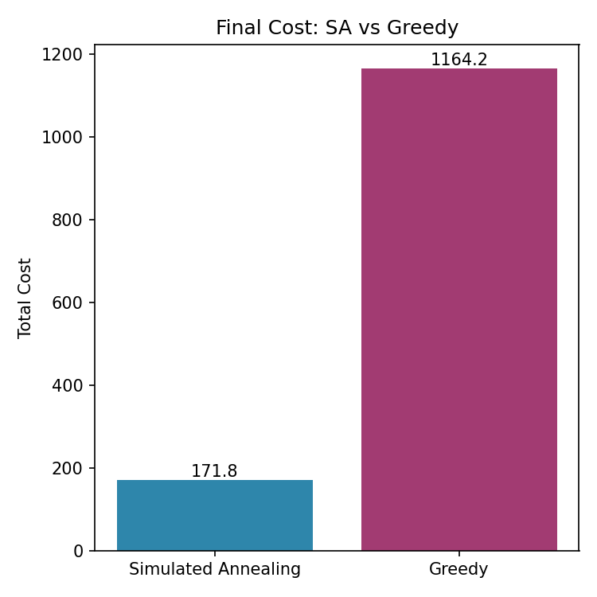
RESULTS
SA beats the greedy baseline by 85%
GREEDY (nearest-assignment)
Each zone picks its closest drone independently — one drone gets overloaded past its battery cap, triggering a heavy penalty.
SIMULATED ANNEALING
Rebalances load across drones to respect every battery cap, cutting total cost from 1164.2 to 171.8.
Final cost — Greedy: 1164.2 | Simulated Annealing: 171.8 | Improvement: 85.2%
6

Slide 7
RELEVANCE & FUTURE SCOPE
Why this matters beyond the classroom
Disaster relief
Last-mile delivery
Field inspection
Fast, battery-aware routing of survey/delivery drones over affected zones.
Balancing packages across a limited drone fleet to cut total flight distance.
Assigning inspection points to UAVs in agriculture, solar farms, or pipelines.
FUTURE SCOPE
Quantum annealing (e.g. D-Wave) could explore the same assignment landscape via quantum tunneling instead of thermal noise — a natural next step once classical SA's limits are reached.
7

